Slide 1
Investment appeal map of Central Asian and South Caucasian countries
2020

Slide 2
Who we are
Expert Center "Eurasian Development" or ECED
— Founded in 2013;
— Unites leading experts from Russia, post-Soviet countries, Turkey and Iran;
— Provides services as a specialized agency for political and
investment consulting and project support in the region.

Slide 3
Goals of the research
The main purpose of the study is formation of the rating of Central Asian and South Caucasian countries in terms of investment attractiveness, business environment, political stability and guarantees protection of investors' rights.
The evaluation of investment attractiveness was made according to the analysis of region countries development, assessment of the sustainability of political institutions work, assessment of economic potentials, openness and “friendliness” with internal and external investors.

Slide 4
Development results of Central Asian and South Caucasian countries economy for 25 years
In 2021 Central Asian and South Caucasian countries celebrated the 30th anniversary of their independence. This was a sufficient time to form new economic model, to identify long-term development goals , to work out interaction models with internal and external investors.
Almost all region countries failed to achieve a major success in creating a competitive, diversified, open economy, with an effective private property and investor rights protection system. Furthermore, region countries didn’t really set this goal and from the very beginning of independence they mostly used formed economy and industrial heritage of the USSR

Slide 5
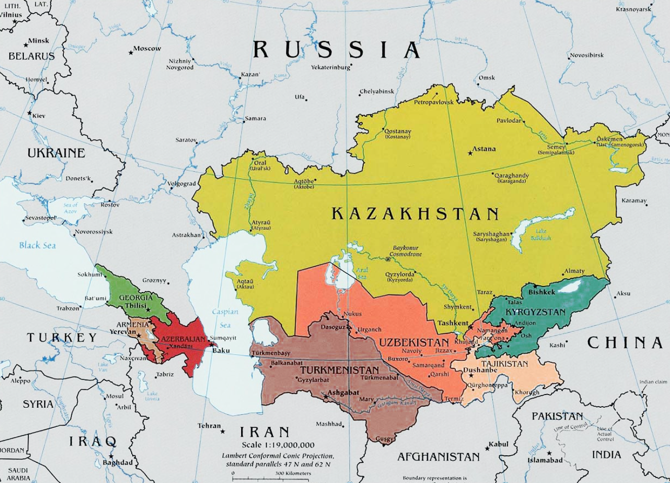
Geography of the study

Slide 6
Investment credit ratings
Country/ criteria | Credit agencies ratings | Transparency International ratings | Doing Business ratings | Total
Azerbaijan | 4.5 | 2.5 | 4.5 | 3.83
Armenia | 3 | 3.5 | 3 | 3.16
Georgia | 4 | 4.5 | 5 | 4.5
Kazakhstan | 5 | 3 | 4 | 4
Kyrgyzstan | 2.5 | 2.5 | 2.5 | 2.5
Tajikistan | 2 | 1.5 | 1.5 | 1.66
Turkmenistan | - | 1 | - | 1
Uzbekistan | 3.5 | 1.5 | 3 | 2.66

Slide 7
Investment credit ratings
Almost all Central Asian and South Caucasian countries, including their companies, are presented in leading country credit ratings like: Doing Business, Moody’s, Fitch, Standart&Poor’s, Transparency International. All these ratings of specialized organizations are very important to understand the whole countries investment attractiveness.
Due to the analysis of countries' positions in these ratings they took their places as follows:
1. Georgia
2. Kazakhstan
3. Azerbaijan
4. Uzbekistan
5.Armenia
6. Kyrgystan
7. Tajikistan
8. Turkmenistan

Slide 8
Macroeconomic indicators
Country/ criteria | Economy Size and Market Capacity | Purchasing power | Foreign trade (size, diversification, trade balance) | Total
Azerbaijan | 4.5 | 3 | 4 | 3.83
Armenia | 3 | 3 | 3 | 3
Georgia | 3 | 3.5 | 2.5 | 3
Kazakhstan | 5 | 5 | 5 | 5
Киргизия | 2 | 2 | 2 | 2
Tajikistan | 2 | 1.5 | 1.5 | 1.66
Turkmenistan | 4 | 1.5 | 3.5 | 3
Uzbekistan | 4 | 2.5 | 4 | 3.5

Slide 9
Macroeconomic indicators
1. Kazakhstan
2. Azerbaijan
3. Uzbekistan
4-5-6. Turkmenistan
4-5-6. Georgia
4-5-6. Armenia
7. Kyrgystan
8. Tajikistan
Macroeconomic indicators of Central Asian and South Caucasian countries are really important for investors to understand total socio-economic situation, assessment of market capacity, prospects for business development in general and in certain sectors.
Due to the analysis of current macroeconomic statistics the rating is:

Slide 10
Transport accessibility
Country/ criteria | Inner transport system | Connectivity | Total
Azerbaijan | 4.5 | 4.5 | 4.5
Armenia | 2 | 1.5 | 1.75
Georgia | 2.5 | 4.5 | 3.5
Kazakhstan | 4 | 4.5 | 4.25
Киргизия | 3 | 3 | 3
Tajikistan | 2.5 | 2.5 | 2.5
Turkmenistan | 3 | 3.5 | 3.25
Uzbekistan | 4.5 | 3.5 | 4

Slide 11
Transport accessibility
The remoteness from world markets and transport infrastructure development are important indicators of investment attractiveness of any state. For Central Asian and South Caucasian countries this fact is even more important, due to the fact that only Georgia has access to the world ocean.
The rating of transport accessibility is illustrated in this table:
1. Azerbaijan
2. Kazakhstan
3.Uzbekistan
4. Georgia
5. Turkmenistan
6. Kyrgyzstan
7. Tajikistan
8. Armenia

Slide 12
Economic development and reformation programs
Country/ criteria | The scale and realism of development programs | The degree of implementation of the declared programs | Total
Azerbaijan | 3 | 3 | 3
Armenia | 2 | 1.5 | 1.75
Georgia | 2.5 | 3.5 | 3.5
Kazakhstan | 5 | 4 | 4.25
Киргизия | 3 | 2.5 | 3
Tajikistan | 2.5 | 2 | 2.5
Turkmenistan | 2 | 1 | 1.5
Uzbekistan | 5 | 4.5 | 4.25

Slide 13
Economic development and reformation programs
The availability of government-approved development programs, strategies of economic growth, the degree of their elaboration and the adequacy of the real situation are really important to understand the problem and prospects of region countries economy. That is why we analyzed current official strategies and program documents in our research.
1. Kazakhstan
2. Uzbekistan
3. Azerbaijan
4. Georgia
5. Kyrgyzstan
6. Tajikistan
7. Armenia
8. Turkmenistan

Slide 14
Political stability
Country/ criteria | Stability of foreign policy | Stability of domestic policy | Total
Azerbaijan | 4 | 4.5 | 4.25
Armenia | 3 | 3.5 | 3.25
Georgia | 2 | 2.5 | 2.25
Kazakhstan | 4.5 | 3.5 | 4
Kyrgysztan | 3.5 | 2.5 | 3
Tajikistan | 3 | 3.5 | 3.25
Turkmenistan | 2 | 3.5 | 2.75
Uzbekistan | 4.5 | 5 | 4.75

Slide 15
Political stability
One of the most important factors of investment attractiveness is an assessment of political risks. This is really important for countries with unstable political institutions. We analyzed the political situation in region countries and evaluated the political stability and predictability of political processes.
1. Uzbekistan
2. Azerbaijan
3. Kazakhstan
4-5.Tajikistan
4-5. Armenia
6. Turkmenistan
7. Kyrgyzstan
8. Georgia

Slide 16
Investment policy
Country/ criteria | Development of legislation to protect investor rights | State and public institutions responsible for attracting and protecting investors | Total
Azerbaijan | 3 | 3 | 3
Armenia | 3 | 3.5 | 3.25
Georgia | 3.5 | 3.5 | 3.5
Kazakhstan | 4.5 | 4 | 4.25
Kyrgyzstan | 3 | 2.5 | 2.75
Tajikistan | 3 | 2.5 | 2.75
Turkmenistan | 1 | 1 | 1
Uzbekistan | 4.5 | 4 | 4.25

Slide 17
Investment policy
One of the most important factors for assessing investment attractiveness is the development of legislation on the protection of investment rights, the regulation of the work of foreign investors in the country, the existence of institutions to protect the rights and interests of investors. This is especially true for countries with unstable political institutions.
We analyzed the existing legislation on licensing, protection of investors' rights, conducted a review of existing institutions for the protection of investors.
1-2. Uzbekistan
1-2. Kazakhstan
3. Georgia
4-5.Armenia
4-5. Azerbaijan
6. Kyrgyzstan
7. Tajikistan
8. Turkmenistan

Slide 18
Investment risks
One of the most important factors for assessing investment attractiveness is the development of legislation on the protection of investment rights, the regulation of the work of foreign investors in the country, the existence of institutions to protect the rights and interests of investors. This is especially true for countries with unstable political institutions.
We analyzed negative cases with investors, problems with implementations of laws and legislation the protection of investors.
1. Kazakhstan
2. Azerbaijan
3. Georgia
4.Uzbekistan
5. Armenia
6. Tajikistan
7.Kyrgyzstan
8. Turkmenistan

Slide 19
Cooperation with EAEU
The development of the Eurasian Integration Project influence the invest climate in Central Asian and South Caucasian countries. It includes its opportunities and risks.
Opportunities:
Access to a capacious EAEU market, which stretches from the eastern borders of Poland to the shores of the Pacific
Prospects of mutual creation of production chains with Russia and Belorussia, including the field of high-tech products
Creation of the most important common markets for EAEU participants by 2025. Markets of: electro energy, natural gas, oil and oil products. This will help with the positive and long-term economic development of the countries-participants

Slide 20
Cooperation with EAEU
Opportunities :
Opportunity of collective defense of economic interests and joint entry into the markets of third countries with whom the EAEU has concluded agreements on the establishment of free trade zones
Access to additional sources of funding— credits of the Eurasian Development Bank and the Eurasian Stabilization and Development Fund
Introduction of unified principles of macroeconomic regulation practices based on modern world practices, and the coordination of economic policies

Slide 21
Total ranking
Country/ criteria | Azer. | Arm. | Geo. | Kyrg. | Kazak. | Taj. | Turk. | Uzb.
Investment ratings | 3.83 | 3.16 | 4.5 | 2.5 | 4 | 1.66 | 3 | 2.66
Macroeconomics | 3.83 | 3 | 3 | 2 | 5 | 1.66 | 3.25 | 3
Connectivity | 4.5 | 1.75 | 3 | 3 | 4.25 | 2.5 | 1 | 4
Programs of development | 3 | 2 | 3.75 | 2.75 | 4.75 | 2.5 | 1 | 4.75
Political stability | 4.25 | 3.25 | 2.25 | 3 | 4 | 3.5 | 3.25 | 4.75
Investment policy | 3 | 3.25 | 3.5 | 2.75 | 4.25 | 1 | 1 | 4.25
Investment risks | 4 | 2.5 | 4 | 2 | 4.5 | 2.5 | 1 | 3
Total | 3.77 | 2.45 | 3.42 | 2.57 | 4.39 | 2.08 | 1.92 | 3.77

Slide 22
Investment appeal map of Central Asian and South Caucasian countries
1. Kazakhstan
2-3. Azerbaijan
2-3. Uzbekistan
4. Georgia
5. Kyrgyzstan
6. Armenia
7. Tajikistan
8. Turkmenistan

Slide 23
Kazakhstan №1
Kazakhstan took the first place in our rating. His strong sides are: serious economic potential, capacious market(17 million people + markets of EAEU countries), a legal framework focused on attracting investors, complex of programs for the development of non-oil economy, and creation of favorable conditions for investments in these spheres.
Population: 19.4 mln.
GDP: 171 bln dollars (IMF, 2019)
GDP per capita: 11160 dollars (IMF, 2019)
Key sectors : oil and gas production, metallurgy, agricultural, transportation

Slide 24
Uzbekistan№2-3
Uzbekistan took the third place in our rating, with the capacious interior market (more than 30 million people), diversified economy, personal resource base, political stability. Besides, there is a huge amount of plans for system reform of the economy of the republic and creation of favorable conditions for investors outlined by the president S.Mirzieev. At the same time there is a strong government interference in the economy, violations of investors' and entrepreneurs’ rights, corruption and bureaucracy, social contradictions, low purchasing power of the population.
Population : 33 mln.
ВВП: 41.24 bln dollars (IMF, 2019)
GDP per capita: 1262 dollars (IMF, 2019)
Key sectors : oil and gas production, metallurgy, machinery, agricultural, transportation, tourism.

Slide 25
Azerbaijan №2-3
Azerbaijan took the second place with the help of their significant resource potential, good transport accessibility and transit opportunities, relatively capacious market (9,5 million people), oriented on access to economic policy, as well as to a set of measures of economic reformation, diversification and creation of its attractiveness for foreign investors.
Population: 9,5 mln
GDP: 46.94 bln. dollars (IMF, 2019)
GDP per capita: 5796 dollars (IMF, 2019)
Key sectors : oil and gas production, metallurgy, agricultural, transportation

Slide 26
Грузия №4
Georgia took the fourth place with its favorable conditions for doing business, advantageous transit location, relatively diversified economy, sufficiently skilled labor force, strengthening economic and migration links with the EU. At the same time Georgia has deep structure problems in economy due to the severance of relations with traditional economic partners, presence of unresolved foreign policy disputes (situation with Abkhazia and South Ossetia, conflict with Russia), poor resource provision, low production efficiency, risks of social protests
Population: 3.720 mln.
GDP: 16.01 bln. Dollars (IMF, 2019)
GDP per capita: 4469 dollars (IMF, 2019)
Key sectors : agricultural, transportation, tourism

Slide 27
Kyrgystan №5
Kyrgyzstan took the fifth place in our rating with relatively liberal legislation and the authorities' actions to create favorable conditions for investments. The republic is full of inexpensive labor, favorable conditions for agriculture, light industry and tourism development. Kyrgyzstan is also a participant of the country in the work of the EAEU in entering the unified association market. At the same time the interference of the state in the economy, has a number of serious precedents of creating difficulties for foreign investors in the implementation of projects in the republic, a multiple revision of early agreements with foreign investors, High risks of political instability, the spread of Islamist ideology, narrowness of the internal market, low labor qualification.
Population: 6.4 mln.
GDP: 8 bln dollars (IMF, 2019)
GDP per capita: 1087 dollars (IMF, 2019)
Key sectors : tourism, metallurgy, agricultural, transportation

Slide 28
Armenia №6
Armenia took the sixth place in our rating, with its relatively diversified economy, sufficiently qualified labor, relatively favorable invest-climate. At the same time there are some high foreign policy risks for the republic (threat of armed conflict with Azerbaijan), we also need to figure the transport blockade, insignificant resource base, the presence of social contradictions and risks of political destabilization.
Population: 2.90 mln
GDP: 12.43 bln dollars(IMF, 2019)
GDP per capita: 4407 dollars (IMF, 2019)
Key sectors : agricultural, transportation, tourism

Slide 29
Tajikistan №7
Tajikistan took the seventh place in our rating with inexpensive labor, the presence of a number of minerals and favorable climate for the agriculture development. At the same time the republic is characterized by underdeveloped infrastructure, narrow interior market, high risks of political destabilization, corruption and bureaucracy, government intervention in the economy, lack of real mechanisms for entrepreneurs to protect their rights.
Population: 9.3 mln.
GDP: 7.5 bln dollars (IMF, 2019)
GDP per capita 1073dollars (IMF, 2019)
Key sectors : agricultural, energy

Slide 30
Turkmenistan №8
газа
Turkmenistan took the last place in our rating, in spite of the availability of large hydrocarbon reserves, the available transit potential, political stability and continuity of the economic course, the authorities adoption of measures to reform the economy and maintain stability in society. The republic has its tough political model, which implies a serious control over any economic activity in the country. The country is characterized by weak protection of property rights, high corruption and bureaucracy, dependence on hydrocarbon exports and a risk of destabilization due to the crisis in Afghanistan
Population : 5.37 mln
GDP: 40.76 млрд. долларов (IMF, 2019)
GDP per capita: 7640 dollars (IMF, 2019)
Key sectors: production of natural gas, agricultural

Slide 31
Services
The full package “Map of investment attractiveness of the countries of Central Asia and the South Caucasus 2020” - a complete overview of the investment climate, opportunities for your business and the risks involved. The cost is 4000 dollars + free consultation (1 hour) in the selected sector of the economy or country.
The Country package (overview of all aspects of the investment climate and analysis of opportunities / risks, but for a single country of interest to you). The cost is 1000 dollars.
The industry package (an overview of a particular sector of the Map, for example, an overview of the political risks of all the countries of the Regina or a comparative analysis of investment legislation). The cost is 1000 dollars.
Consultation (review of the sector of economy or the investment climate of the country that interests you). The cost is 700 dollars an hour.

Slide 32
Contact details
WebSite: www.e-ced.ru/en
Stanislav Pritchin
Ph: +79269845543
Email: Pritchin.Stanislav@gmail.com
Pritchin.Stanislav@yandex.ru

Slide 33
Thank you for your attention!

