Slide 1
Investment appeal map of Central Asian and South Caucasian countries
Expert Center for Eurasian Development - ECED
2017

Slide 2
Development results of Central Asian and South Caucasian countries economy for 25 years
In 2016 Central Asian and South Caucasian countries celebrated the 25th anniversary of their independence. This was a sufficient time to form new economic model, to identify long-term development goals , to work out interaction models with internal and external investors.
Almost all region countries failed to achieve a major success in creating a competitive, diversified, open economy, with an effective private property and investor rights protection system. Furthermore, region countries didn’t really set this goal and from the very beginning of independence they mostly used formed economy and industrial heritage of the USSR.

Slide 3
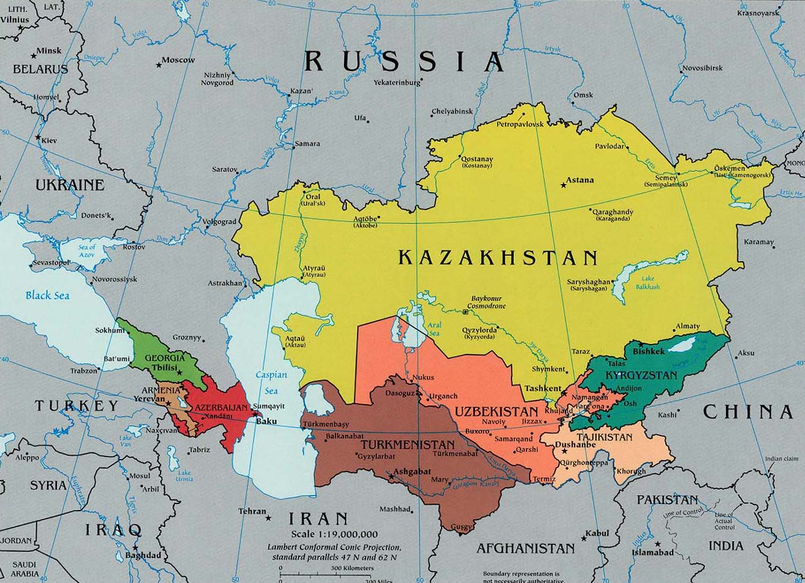
Development results of Central Asian and South Caucasian countries economy for 25 years
Nowadays, none of the states can count on qualitative development, improvement of social and economic situation without the help of foreign investments and best practices and technologies.

Slide 4
Purpose of the study
The main purpose of the study is formation of the rating of Central Asian and South Caucasian countries in terms of investment attractiveness, business environment, political stability and guarantees protection of investors' rights.
The evaluation of investment attractiveness was made according to the analysis of region countries development, assessment of the sustainability of political institutions work, assessment of economic potentials, openness and “friendliness” with internal and external investors.

Slide 5
Investment credit ratings
Almost all Central Asian and South Caucasian countries, including their companies, are presented in leading country credit ratings like: Doing Business, Moody’s, Fitch, Standart&Poor’s, Transparency International. All these ratings of specialized organizations are very important to understand the whole countries investment attractiveness.
Due to the analysis of countries' positions in these ratings they took their places as follows:
1. Kazakhstan
2. Georgia
3. Azerbaijan
4. Armenia
5. Kyrgyzstan
6. Uzbekistan
7. Tajikistan
8. Turkmenistan

Slide 6
Macroeconomic indicators
Macroeconomic indicators of Central Asian and South Caucasian countries are really important for investors to understand total socio-economic situation, assessment of market capacity, prospects for business development in general and in certain sectors.
Due to the analysis of current macroeconomic statistics the rating is:
1. Kazakhstan
2. Uzbekistan
3. Azerbaijan
4. Turkmenistan
5. Georgia
6. Armenia
7. Kyrgyzstan
8. Tajikistan

Slide 7
Transport accessibility
The remoteness from world markets and transport infrastructure development are important indicators of investment attractiveness of any state. For Central Asian and South Caucasian countries this fact is even more important, due to the fact that only Georgia has access to the world ocean.
The rating of transport accessibility is illustrated in this table:
1. Kazakhstan
2. Georgia
3. Azerbaijan
4. Turkmenistan
5. Kyrgyzstan
6. Uzbekistan
7. Tajikistan
8. Armenia

Slide 8
Economic development and reformation programs
The Availability of government-approved development programs, strategies of economic growth, the degree of their elaboration and the adequacy of the real situation are really important to understand the problem and prospects of region countries economy. That is why we analyzed current official strategies and program documents in our research.
1. Kazakhstan
2. Uzbekistan
3. Azerbaijan
4. Georgia
5. Kyrgyzstan
6. Tajikistan
7. Armenia
8. Turkmenistan

Slide 9
Political stability
One of the most important factors of investment attractiveness is an assessment of political risks. This is really important for countries with unstable political institutions. We analyzed the political situation in region countries and evaluated the political stability and predictability of political processes.
1. Uzbekistan
2. Azerbaijan
3. Turkmenistan
4. Kazakhstan
5. Georgia
6. Tajikistan
7. Armenia
8. Kyrgyzstan

Slide 10
Final rating
1. Kazakhstan
2. Azerbaijan
3. Uzbekistan
4. Georgia
5. Kyrgyzstan
6. Armenia
7. Tajikistan
8. Turkmenistan

Slide 11
Characteristics: Kazakhstan №1
Kazakhstan took the first place in our rating. His strong sides are: serious economic potential, capacious market(17 million people + markets of EAEU countries), a legal framework focused on attracting investors, complex of programs for the development of non-oil economy, and creation of favorable conditions for investments in these spheres.
The outlook for Kazakhstan will be rather negative, because in the near or medium term there will be a transit of power.

Slide 12
Characteristics : Azerbaijan №2
Azerbaijan took the second place with the help of their significant resource potential, good transport accessibility and transit opportunities, relatively capacious market (9,5 million people), oriented on access to economic policy, as well as to a set of measures of economic reformation, diversification and creation of its attractiveness for foreign investors.
The outlook of invest-climate of Azerbaijan will be negative, due to the high possibility of escalation of the conflict in Nagorno-Karabakh, and also due to the risks of socio-economic tension growth.

Slide 13
Characteristics : Uzbekistan №3
Uzbekistan took the third place in our rating, with the capacious interior market (more than 30 million people), diversified economy, personal resource base, political stability. Besides, there is a huge amount of plans for system reform of the economy of the republic and creation of favorable conditions for investors outlined by the new president S.Mirzieev. At the same time there is a strong government interference in the economy, the non-liberalized currency market, violations of investors' and entrepreneurs’ rights,
corruption and bureaucracy, social contradictions, low purchasing power of the population.
Given the government's stated plans the outlook for Uzbekistan will be positive.

Slide 14
Georgia took the fourth place with its favorable conditions for doing business, advantageous transit location, relatively diversified economy, sufficiently skilled labor force, strengthening economic and migration links with the EU. At the same time Georgia has deep structure problems in economy due to the severance of relations with traditional economic partners, presence of unresolved foreign policy disputes (situation with Abkhazia and South Ossetia, conflict with Russia), poor resource provision,
Characteristics : Georgia №4
low production efficiency, risks of social protests. The outlook of invest-climate of Georgia is going to be neutral, which means that there will be no serious climate changes.

Slide 15
Characteristics: Kyrgyzstan №5
Kyrgyzstan took the fifth place in our rating with relatively liberal legislation and the authorities' actions to create favorable conditions for investments. The republic is full of inexpensive labor, favorable conditions for agriculture, light industry and tourism development. Kyrgyzstan is also a participant of the country in the work of the EAEU in entering the unified association market. At the same time the interference of the state in the economy, has a number of serious precedents of creating difficulties for foreign investors in the implementation of projects in the republic, a multiple
revision of early agreements with foreign investors, lack of political continuity,
High risks of political instability, the spread of Islamist ideology, narrowness of the internal market, low labor qualification. The outlook for Kyrgyzstan will be negative due to the forthcoming elections in 2017 and current uncertainty of the future political force.

Slide 16
Characteristics: Armenia №6
Armenia took the sixth place in our rating, with its relatively diversified economy, sufficiently qualified labor, relatively favorable invest-climate. At the same time there are some high foreign policy risks for the republic (threat of armed conflict with Azerbaijan), we also need to figure the transport blockade, insignificant resource base, the presence of social contradictions and risks of political destabilization.
The outlook of invest-climate of Armenia is negative.

Slide 17
Characteristics : Tajikistan №7
Tajikistan took the seventh place in our rating with inexpensive labor, the presence of a number of minerals and favorable climate for the agriculture development. At the same time the republic is characterized by underdeveloped infrastructure, narrow interior market, high risks of political destabilization, corruption and bureaucracy, government intervention in the economy, lack of real mechanisms for entrepreneurs to protect their rights.
The outlook for Tajikistan will be negative.

Slide 18
Characteristics : Turkmenistan №8
Turkmenistan took the last place in our rating, in spite of the availability of large hydrocarbon reserves, the available transit potential, political stability and continuity of the economic course, the authorities adoption of measures to reform the economy and maintain stability in society. The republic has its tough political model, which implies a serious control over any economic activity in the country. The country is characterized by weak protection of property rights, high
corruption and bureaucracy, dependence on hydrocarbon exports and a risk of destabilization due to the crisis in Afghanistan. The outlook for Turkmenistan is negative.

Slide 19
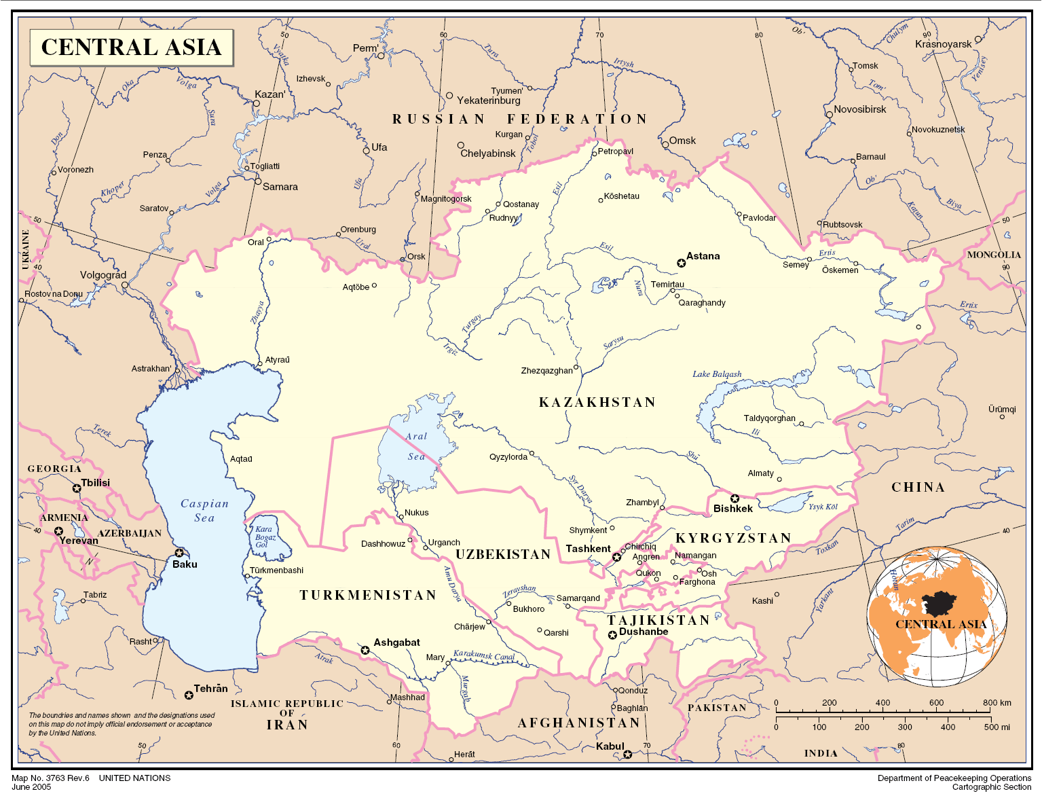
Rating of Central Asian countries
Regionally, among Central Asian countries the rating of investment attractiveness is:
1
2
3
5
4

Slide 20
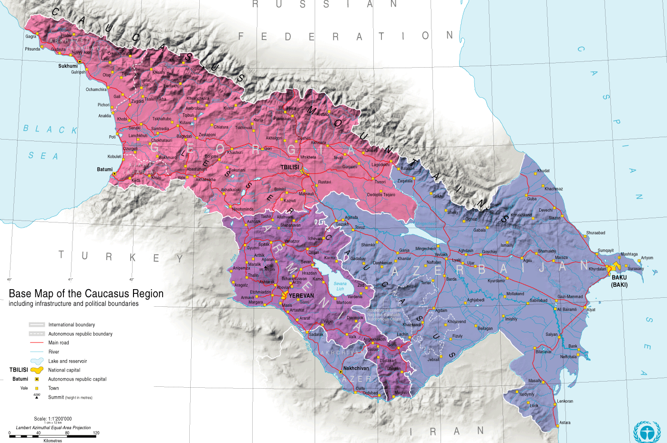
Rating of South Caucasian countries
South Caucasian countries are located in the rating of investment attractiveness like:
2
1
3

Slide 21
Cooperation with EAEU
The development of the Eurasian Integration Project influence the invest climate in Central Asian and South Caucasian countries. It includes its opportunities and risks.
Opportunities:
Access to a capacious EAEU market, which stretches from the eastern borders of Poland to the shores of the Pacific
Prospects of mutual creation of production chains with Russia and Belorussia, including the field of high-tech products
Creation of the most important common markets for EAEU participants by 2025. Markets of: electro energy, natural gas, oil and oil products. This will help with the positive and long-term economic development of the countries-participants

Slide 22
Cooperation with EAEU
Opportunities :
Opportunity of collective defense of economic interests and joint entry into the markets of third countries with whom the EAEU has concluded agreements on the establishment of free trade zones
Access to additional sources of funding— credits of the Eurasian Development Bank and the Eurasian Stabilization and Development Fund
Introduction of unified principles of macroeconomic regulation practices based on modern world practices, and the coordination of economic policies

Slide 23
Cooperation with EAEU
Risks:
Strengthening of the economies interdependence increases the likelihood of a negative impact of the crisis phenomena in one of the member countries of the EAEU on other states
Preservation of a large number of barriers, exemptions and restrictions in the work of the integration association reduces the benefits of partnership within the union
Presence of serious political risks— frictions and disputes between the participants of the association, as well as the relationship of Russian Federation with the West countries, have a general negative impact on the functioning of the EAEU

Slide 24
Cooperation of Central Asian and South Caucasian countries with EAEU
Participants | Perspective partnership | Outsiders
Armenia | Azerbaijan | Georgia
Kazakhstan | Tajikistan | Turkmenistan
Kyrgyzstan | Uzbekistan

Slide 25
Cooperation of Central Asian and South Caucasian countries with EAEU (by country)
Armenia — a member of the «second wave». The country has more stable positions, then Kyrgyzstan due to a more developed economy, greater political weight and influence of the country in the CIS, a strong political and economic lobby in Russia. The presence of a huge potential to increase exports, which has already brought dividends to Armenia(in 2016 export in Russia increased by 50%). The main growth possibilities are concentrated in the food industry, in the mining sector (copper, molybdenum concentrate and a number of other positions). Kazakhstan — a system-forming state in the integration association. Kazakhstan is one of the founders of EAEU. It benefits the use of the transport and logistics potential of the integration association, projects financing on its own territory by the Eurasian Development Bank. The perspective of multiple increase in exports to a single market for a number of commodity items (from the agricultural sector to the chemical and metallurgical industries).

Slide 26
Cooperation of Central Asian and South Caucasian countries with EAEU (by country)
Kyrgyzstan — a member of the «second wave». Nowadays the governments role in the working process of the integration association is small. However in 2017 Kyrgyzstan will chair the EAEU, that will make a positive effect on countries positions in the association. The introduction of norms and practices of regulation of EAEU is really perspective for Kyrgyzstan, because it Will promote the progress of economic life in the country. At the same time the country has a strong export potential in food industry and in light industry.

Slide 27
Cooperation of Central Asian and South Caucasian countries with EAEU (not in EAEU)
A Significant development potential is the connection of EAEU with Uzbekistan, who will remain interested in attracting investments, building economic cooperation and facilitating the conditions for the withdrawal of its own products to EAEU market in the coming years. Tajikistan is interested in economic cooperation with Russia, other CIS countries and EAEU. In the medium term, the issue of joining Dushanbe to an integration association may arise. However due to the weakness of Tajikistan economy in terms of institutions and the availability of economic assets, the potential for developing ties with EAEU is quite modest. As for Azerbaijan, trade and economic relations of EAEU have a good potential for development in agricultural products supply.

Slide 28
Cooperation of Central Asian and South Caucasian countries with EAEU (not in EAEU)
The outsider for the development of cooperation with EAEU is Georgia. The Transcaucasian state has a complex political relationship with Moscow and a political-economic course oriented toward the Euro-Atlantic community. Another important outsider is Turkmenistan – a country with a clearly expressed raw material character of the economy, adhering to the isolationist approach to the interaction with Russia and other CIS countries. The prospects for cooperation between Turkmenistan and the EAEU are poorly seen.

Slide 29
Research Methodology
The main task of the study was to identify countries with the best balance of potential for investment, with existing political and economic risks for investors. We analyzed such ratings as: Doing business, Moody’s, Fitch, Standart&Poor’s. Such macroeconomic indicators as (GDP, GDP (per capita), inflation, unemployment, the number of employees in the economy, foreign trade and balance, the balance of payments) were considered in detail. We also analyzed the transport infrastructure, that links countries to world markets.
Government programs and strategies for economic development are examined in detail. An important factor for the assessment of the investment attractiveness of countries in the context of instability of political institutions is the analysis of political stability and predictability of political processes for investors.

Slide 30
About us
The expert center «Eurasian development» (Expert Center Eurasian Development, ECED), was founded in 2013 as an analytical group of researchers. Nowadays we are a specialized center of political and investment consulting.
Our interests are:
Analysis of political and security risks in the Central Asia, the South Caucasus, the Caspian region
Preparation of political outlook for the development of the situation in the region
Monitoring of investment risks in the Central Asia, the South Caucasus, the Caspian region
Conduction of studies on assessing the development potential, state regulation of certain economic sectors of region countries
Analytical and consulting support of business projects in the region

Slide 31
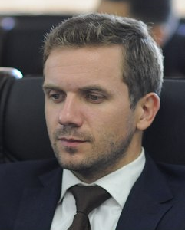
About us
Eced team includes leading Russian experts and representatives of region countries. The heads of the analytical group are PhD. Stanislav Pritchin and PhD. Alexander Vorobiev.
For cooperation please contact us:
pritchin.stanislav@yandex.ru
vorobiov.09@yandex.ru
Alexander Vorobiev
Stanislav Pritchin

